Slide 1
Intro to HTC and HTCondor
Monday, July 25
Lauren Michael
This work was supported by NSF grants MPS-1148698, OAC-1836650, and OAC-2030508

Slide 2
Intro to HTC and OSG

Slide 3
Overview
What is high throughput computing (HTC) ?
What is the OSG?
How do you get the most out of the above?

Slide 4

HTC: An Analogy

Slide 5


HTC: An Analogy

Slide 6
Serial Computing
What many
programs look like:
time
Serial execution, running one task at a time
Overall compute time grows significantly as individual tasks get more complicated (long) or if the number of tasks increases
How can you speed things up?

Slide 7
High Throughput Computing (HTC)
Parallelize!
Independent tasks run on different cores
n cores
time

Slide 8
High Performance Computing (HPC)
n cores
Benefits greatly from:
CPU speed + homogeneity
shared filesystems
fast, expensive networking (e.g. Infiniband) and co-located servers
Requires special programming (MP/MPI)
Scheduling: Must wait until all processors are available, at the same time and for the full duration
What happens if one core or server fails or runs slower than the others?
…
time
…
…

Slide 9
High Throughput Computing (HTC)
n cores
time
Scheduling: only need 1 CPU core for each (shorter wait)
Easier recovery from failure
No special programming required
Number of concurrently running jobs is more important
CPU speed and homogeneity are less important

Slide 10

Example Local Cluster
UW-Madison’s Center for High Throughput Computing (CHTC)
Recent CPU hours:
~120 million hrs/year (~15k cores)
Up to 15,000 per user, per day
(~600 cores in use)
CHTC Pool
single-core
high-memory
multi-core
MPI
GPUs
access point

Slide 11
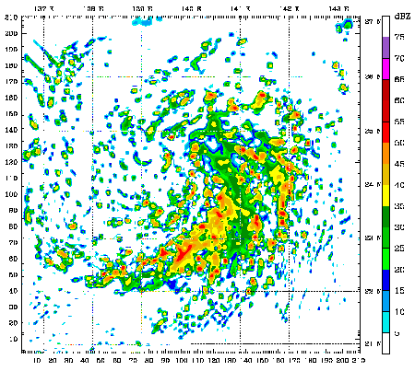
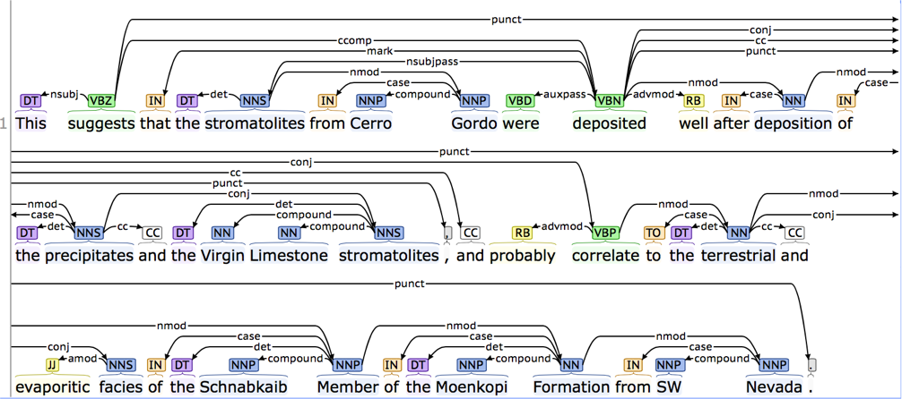

HTC Examples
text analysis (most genomics …)
multi-start simulations
parameter sweeps
statistical model optimization
(MCMC, numerical methods, etc.)
multi-image and
multi-sample analysis

Slide 12
Signs of HTC-able work
Any mention of numerous samples, images, models, parameters, etc.
Nearly anything written by the primary user (e.g. c/fortran, Python, R)
Break out of loops!
Common internal parallelism could really be HTC (e.g. Matlab’s ‘parfor’, ‘distributed server’, etc.)
Some community softwares that use multi-threading or multiprocessing (e.g. OpenMP)
many are simply looping over data portions or independent tasks
HTC-able: break up input (or ‘parameter’ space), turn off multi-threading, combine results
Long-running jobs (especially if non-MPI); see above explanations

Slide 13
Real HTC Use Cases
OSG website ‘Spotlight’
https://osg-htc.org/spotlight.html
OSG All-Hands Meetings (research talks usually day 1)
https://osg-htc.org/all-hands/
HTCondor Week Presentations (usually first or last day)
https://htcondor.org/past_condor_weeks.html

Slide 14
Example Challenge
You need to process 72 brain images for each of 168 patients. Each image takes ~1 hour of compute time.
168 patients x 72 images = ~12000 tasks = ~12000 hrs
Conference is next week.

Slide 15
Distributed Computing
Use many computers, each running one instance of our program
Example:
1 laptop (1 core) => 12,000 hrs = ~1.5 years
1 server (~40 cores) => 750 hrs = ~2 weeks
1 MPI job (400 cores) => 30 hrs = ~1 days
A whole cluster (10,000 cores) = ~1 hour

Slide 16
What computing resources are available?
A server?
A local cluster?
Consider: Queue wait time? Can you program MP/MPI? Typical clusters tuned for HPC (large MPI) jobs may not be best for HTC workflows! Could you use even more than that?
OSG?
Other
EGI (European Grid Infrastructure)
Other national and regional grids
Commercial cloud systems (e.g. HTCondor on AWS)

Slide 17
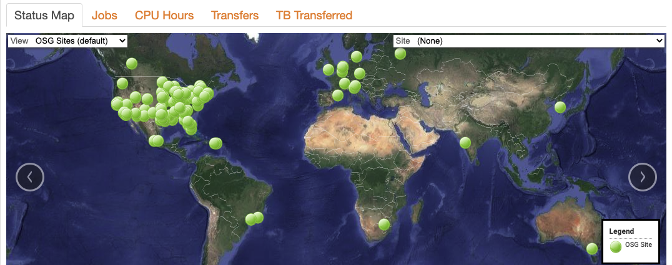
What is the OSG?
a consortium of researchers and institutions who share compute and data resources for distributed high-throughput computing (dHTC) in support of open science

Slide 18
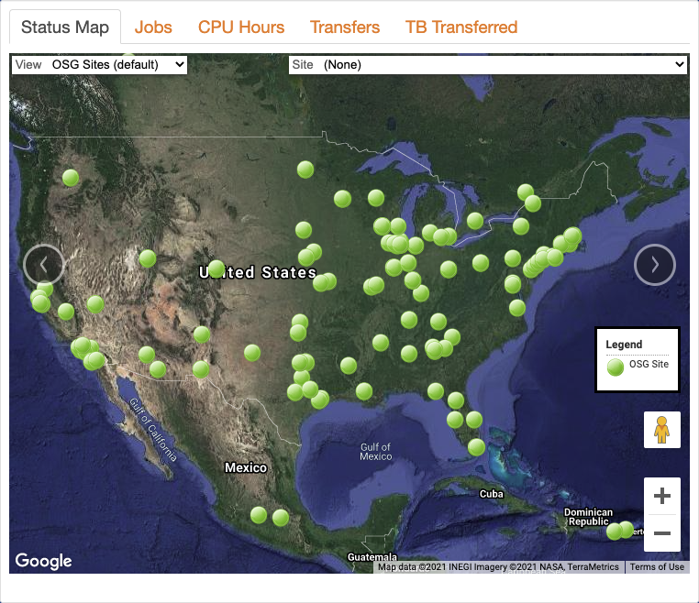
Who Participates?
Researchers
Science Gateways
Multi-Institution Collaborations
Atlas/CMS (Higg Boson), IceCube, South Pole Telescope, and others
Academic Institutions and National Laboratories that support the above
Campuses are critical to OSG’s ability to advance research.

Slide 19
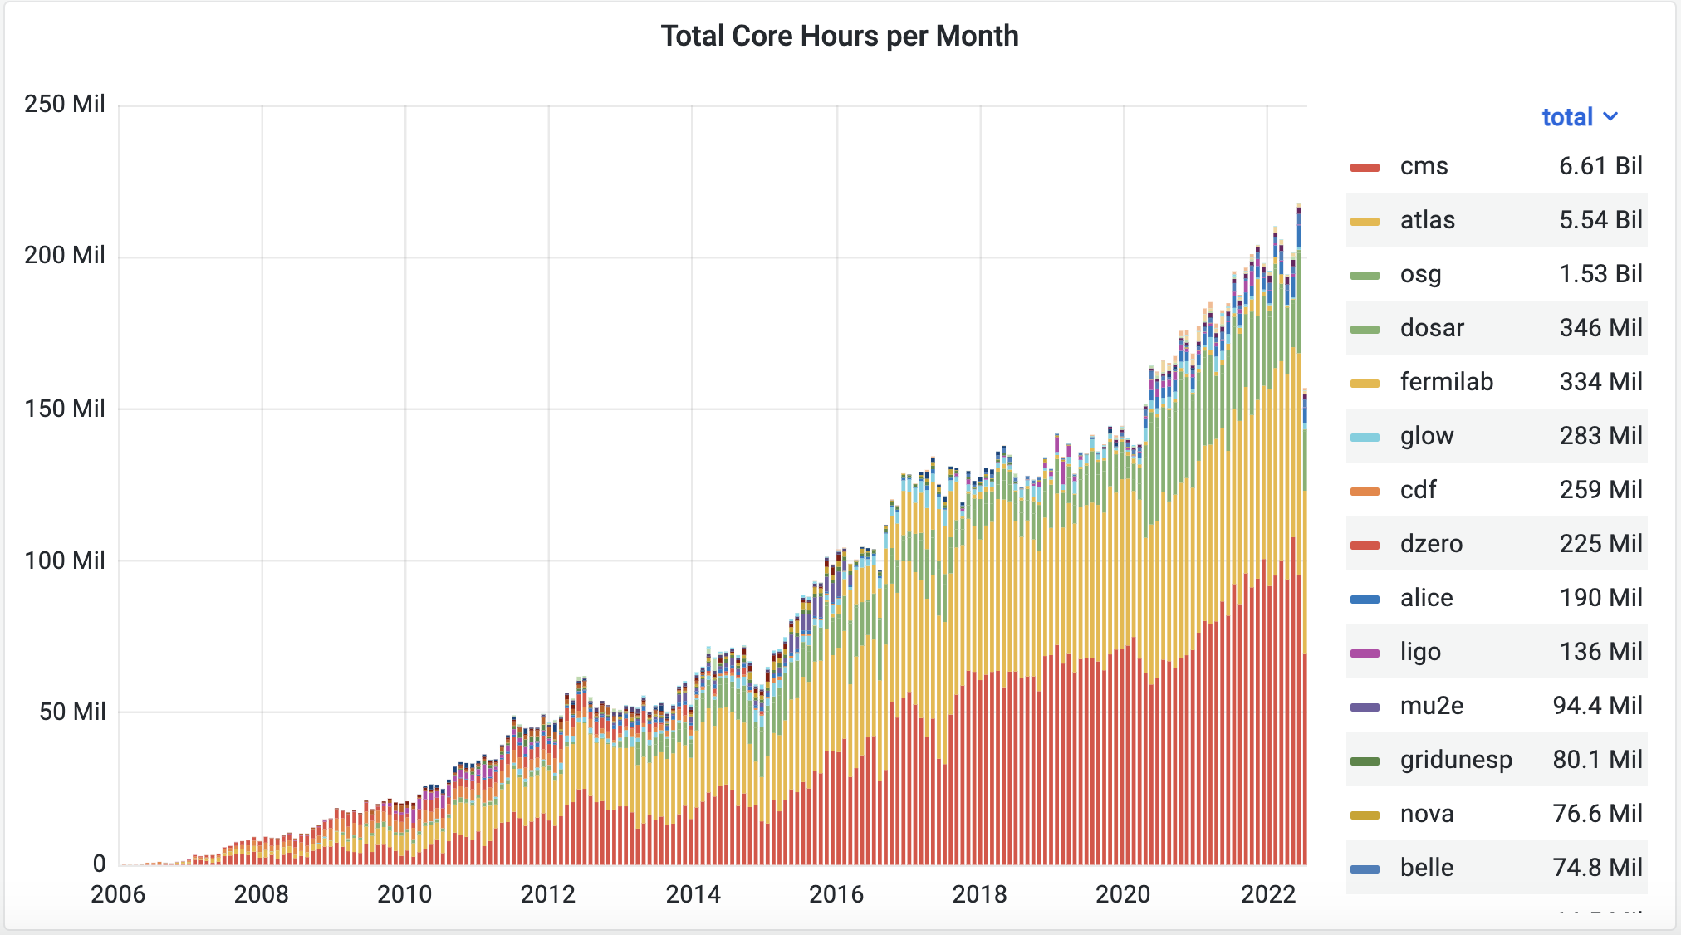
Research Communities (Pools) in the OSG
(“virtual organizations”)
>2 billion hrs in the last year
gracc.opensciencegrid.org

Slide 20


Slide 21


Slide 22
“Open Science Pool”
single researchers/groups (OSG Connect)
smaller multi-institution collaborations
campus access points
gracc.opensciencegrid.org

Slide 23
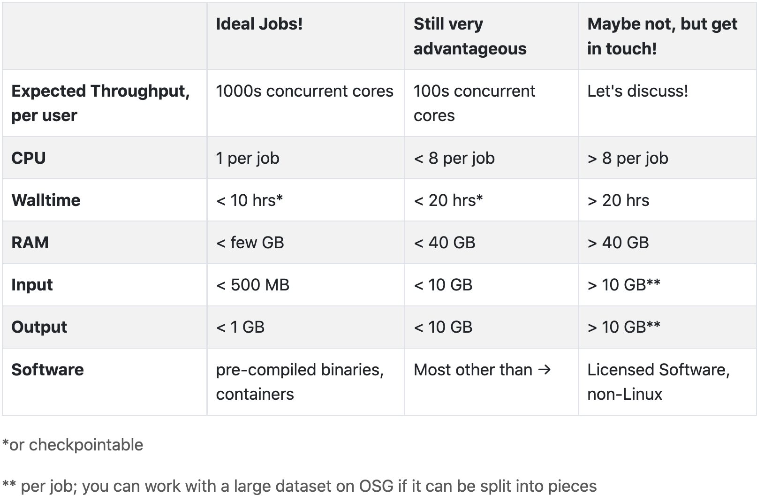
Can the OSPool Help?

Slide 24
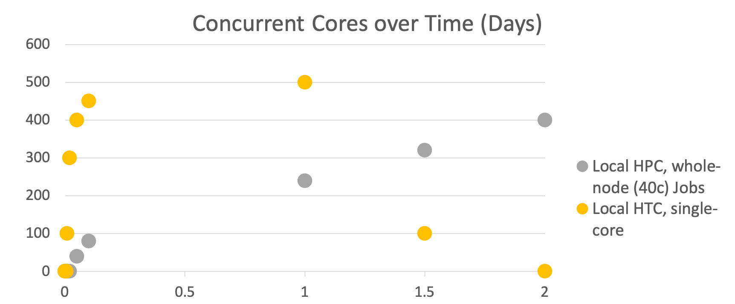
Hypothetical Throughput, 12k core hours

Slide 25
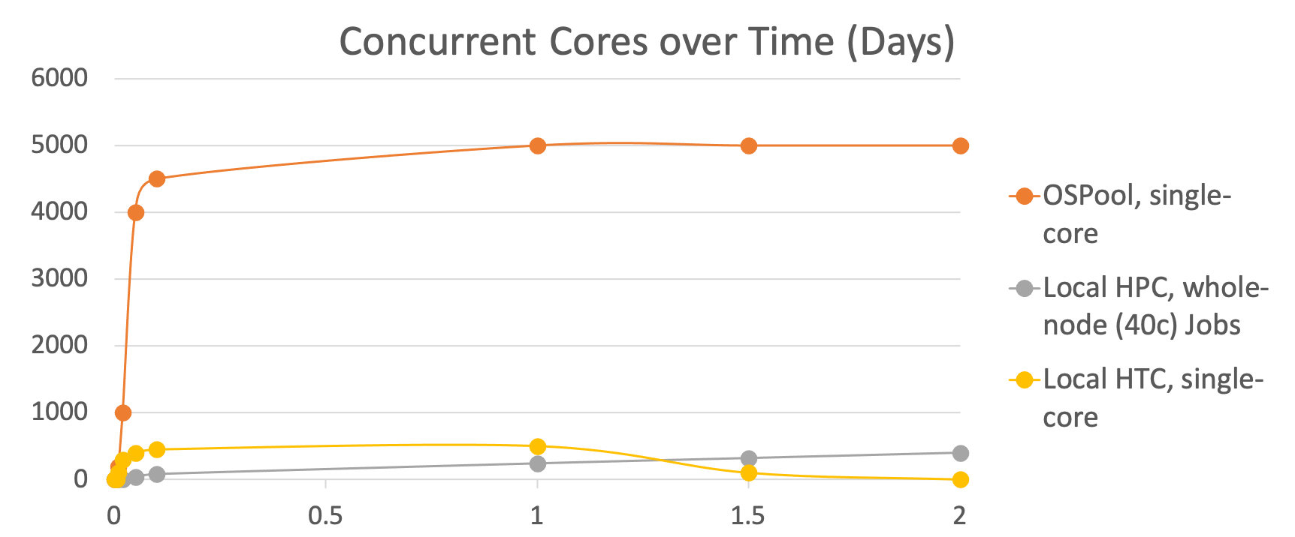
Hypothetical Throughput, 12k core hours

Slide 26
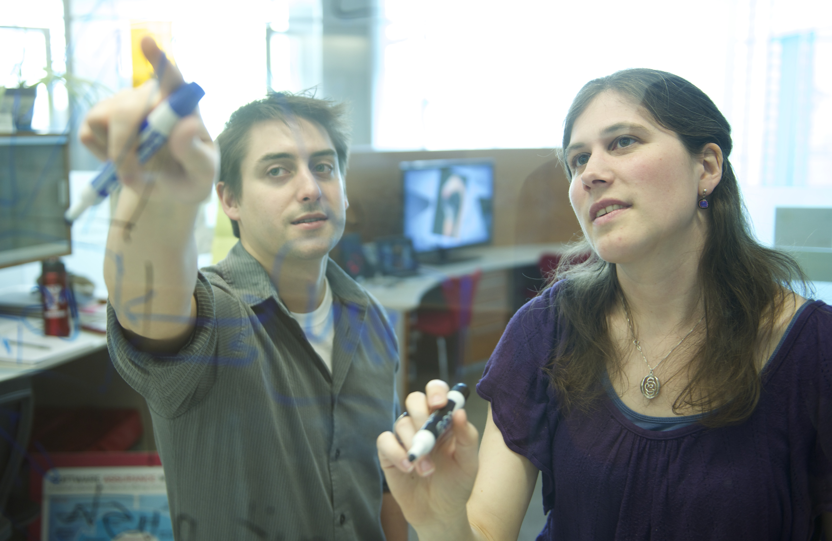
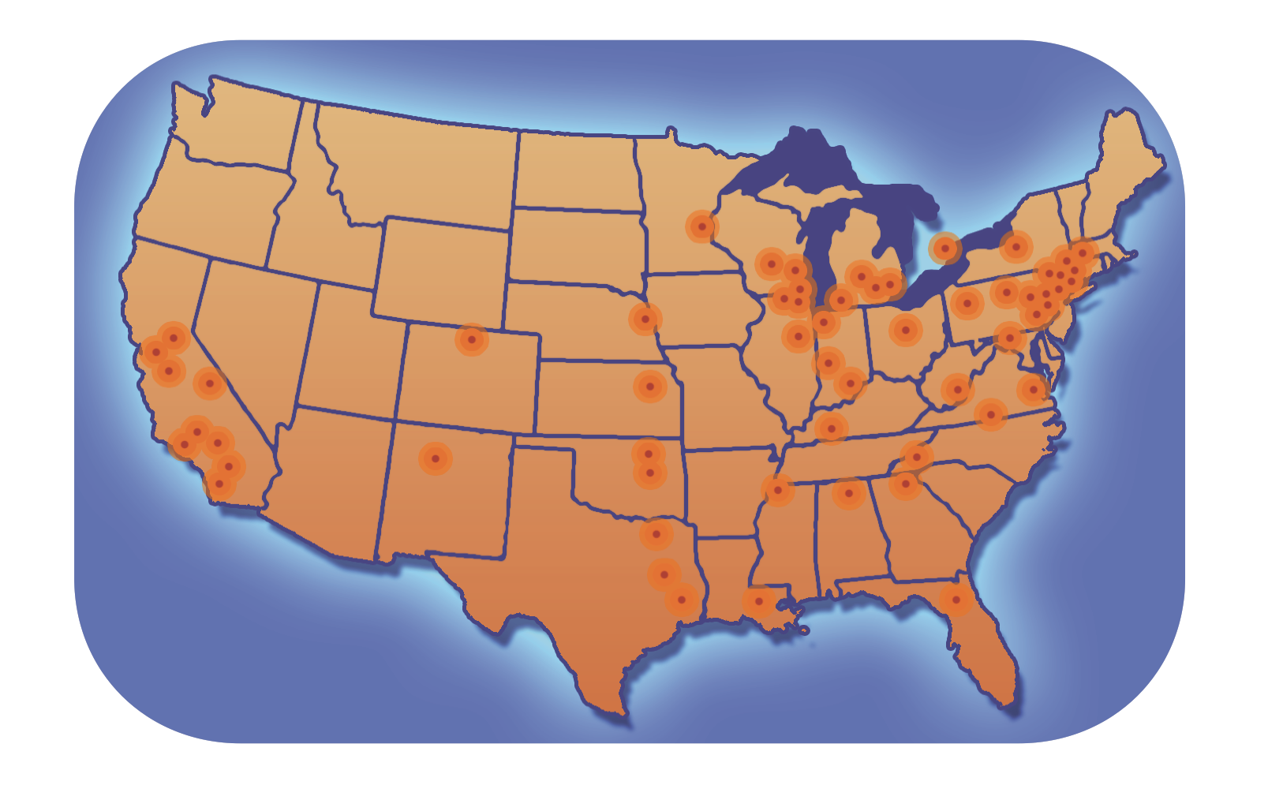
For Researchers and Campuses
Proactive, personalized facilitation and support for:
Individual researchers via OSG Connect
Institutions and large collaborations
Share local resources via the OSG
Locally-supported access points
data and identity federation
integration of cloud capacity
Local HTC Capacity
Learn from OSG’s Research Computing Facilitators
Presentations/Training in OSG compute execution, HTC Facilitation, and local HTC systems administration

Slide 27
Example Local Cluster
UW-Madison’s Center for High Throughput Computing (CHTC)
Recent CPU hours:
~120 million hrs/year (~15k cores)
Up to 15,000hrs per user, per day
(~600 cores in use)
CHTC Pool
single-core
high-memory
multi-core
MPI
GPUs
access point

Slide 28
Intro to Job Submission with HTCondor

Slide 29
Overview
How does the HTCondor job scheduler work?
How do you run, monitor, and review jobs?
Best ways to submit multiple jobs (what we’re here for, right?)
Testing, tuning, and troubleshooting to scale up.

Slide 30

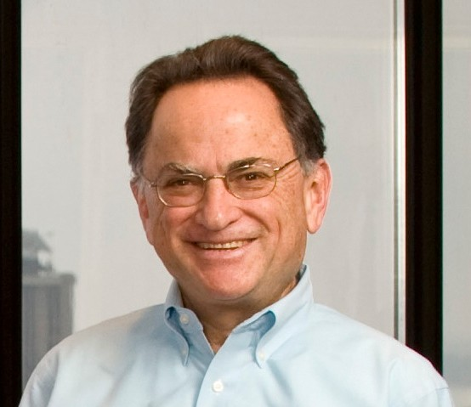
HTCondor History and Status
History
Started in 1988 as a “cycle scavenger”
Today
Developed within the CHTC by professional developers
Used all over the world, by:
campuses, national labs, Einstein/Folding@Home
Dreamworks, Boeing, SpaceX, investment firms, …
The OSG!!
Miron Livny
Professor, UW-Madison Computer Sciences
CHTC Director, OSG Technical Director

Slide 31



HTCondor -- How It Works
Submit tasks to a queue (on a access point)
HTCondor schedules them to run on computers (execute points)
access point
execute point
execute point
execute point

Slide 32
Terminology: Job
Job: An independently-scheduled unit of computing work
Three main pieces:
Executable: the script or program to run
Input: any options (arguments) and/or file-based information
Output: files printed by the executable
In order to run many jobs, executable must run on the command-line without any graphical input from the user

Slide 33

Terminology: Machine, Slot
Machine
A whole computer (desktop or server)
Has multiple processors (CPU cores), some amount of memory, and some amount of file space (disk)
Slot
an assignable unit of a machine (i.e. 1 job per slot)
may correspond to one core with some memory and disk
a typical machine will have multiple slots
HTCondor can break up and create new slots, dynamically, as resources become available from completed jobs

Slide 34

Job Matching
On a regular basis, the central manager reviews Job and Machine attributes and matches jobs to Slots.
execute point
access point
central manager
execute point
execute point
34

Slide 35
Job Execution
Then the access and execute points communicate directly.
execute point
access point
central manager
execute point
execute point
35

Slide 36

Single Computer
slot
slot
queue +
central manager
slot
36

Slide 37
Basic Job Submission

Slide 38
Job Example
program called “compare_states” (executable), which compares two data files (input) and produces a single output file.
wi.dat
compare_
states
wi.dat.out
us.dat
$ compare_states wi.dat us.dat wi.dat.out

Slide 39
Basic Submit File
executable = compare_states
arguments = wi.dat us.dat wi.dat.out
transfer_input_files = us.dat, wi.dat
log = job.log
output = job.out
error = job.err
request_cpus = 1
request_disk = 20MB
request_memory = 20MB
queue 1

Slide 40
Basic Submit File
executable = compare_states
arguments = wi.dat us.dat wi.dat.out
transfer_input_files = us.dat, wi.dat
log = job.log
output = job.out
error = job.err
request_cpus = 1
request_disk = 20MB
request_memory = 20MB
queue 1
List your executable and any arguments it takes
Arguments are any options passed to the executable from the command line
$ compare_states wi.dat us.dat wi.dat.out

Slide 41
Basic Submit File
executable = compare_states
arguments = wi.dat us.dat wi.dat.out
transfer_input_files = us.dat, wi.dat
log = job.log
output = job.out
error = job.err
request_cpus = 1
request_disk = 20MB
request_memory = 20MB
queue 1
comma-separated list of input files to transfer to the slot
wi.dat
us.dat

Slide 42
Basic Submit File
executable = compare_states
arguments = wi.dat us.dat wi.dat.out
transfer_input_files = us.dat, wi.dat
log = job.log
output = job.out
error = job.err
request_cpus = 1
request_disk = 20MB
request_memory = 20MB
queue 1
HTCondor will transfer back all new and changed files (output) from the job, automatically.
wi.dat.out

Slide 43
Basic Submit File
executable = compare_states
arguments = wi.dat us.dat wi.dat.out
transfer_input_files = us.dat, wi.dat
log = job.log
output = job.out
error = job.err
request_cpus = 1
request_disk = 20MB
request_memory = 20MB
queue 1
log: file created by HTCondor to track job progress
Explored in exercises!
output/error: captures stdout and stderr from your program (what would otherwise be printed to the terminal)

Slide 44
Basic Submit File
executable = compare_states
arguments = wi.dat us.dat wi.dat.out
transfer_input_files = us.dat, wi.dat
log = job.log
output = job.out
error = job.err
request_cpus = 1
request_disk = 20MB
request_memory = 20MB
queue 1
request the resources your job needs.
More on this later!
queue: final keyword indicating “create 1 job” according to the above

Slide 45
Submitting and monitoring

Slide 46
Submitting and Monitoring
To submit a job/jobs: condor_submit submit_file
To monitor submitted jobs: condor_q
$ condor_submit job.submit
Submitting job(s).
1 job(s) submitted to cluster 128.
$ condor_q
-- Schedd: learn.chtc.wisc.edu : <128.104.101.92> @ 05/01/22 10:35:54
OWNER BATCH_NAME SUBMITTED DONE RUN IDLE TOTAL JOB_IDS
alice CMD: compare_states 5/9 11:05 _ _ 1 1 128.0
1 jobs; 0 completed, 0 removed, 1 idle, 0 running, 0 held, 0 suspended
HTCondor Manual: condor_submit
HTCondor Manual: condor_q

Slide 47
More about condor_q
By default, condor_q shows your jobs only and batches jobs that were submitted together:
Limit condor_q by username, ClusterId or full JobId, (denoted [U/C/J] in following slides).
$ condor_q
-- Schedd: learn.chtc.wisc.edu : <128.104.101.92> @ 05/01/22 10:35:54
OWNER BATCH_NAME SUBMITTED DONE RUN IDLE TOTAL JOB_IDS
alice CMD: compare_states 5/9 11:05 _ _ 1 1 128.0
1 jobs; 0 completed, 0 removed, 1 idle, 0 running, 0 held, 0 suspended
JobId = ClusterID.ProcID

Slide 48
More about condor_q
To see individual job details, use:
condor_q –nobatch
We will use the -nobatch option in the following slides to see extra detail about what is happening with a job
$ condor_q -nobatch
-- Schedd: learn.chtc.wisc.edu : <128.104.101.92>
ID OWNER SUBMITTED RUN_TIME ST PRI SIZE CMD
128.0 alice 5/9 11:09 0+00:00:00 I 0 0.0 compare_states
128.1 alice 5/9 11:09 0+00:00:00 I 0 0.0 compare_states
...
1 jobs; 0 completed, 0 removed, 1 idle, 0 running, 0 held, 0 suspended

Slide 49
Job Idle
$ condor_q -nobatch
-- Schedd: submit-5.chtc.wisc.edu : <128.104.101.92>
ID OWNER SUBMITTED RUN_TIME ST PRI SIZE CMD
128.0 alice 5/9 11:09 0+00:00:00 I 0 0.0 compare_states wi.dat us.dat
1 jobs; 0 completed, 0 removed, 1 idle, 0 running, 0 held, 0 suspended
Access Point
(submit_dir)/
job.submit
compare_states
wi.dat
us.dat
job.log
job.out
job.err

Slide 50
Job Starts
$ condor_q -nobatch
-- Schedd: submit-5.chtc.wisc.edu : <128.104.101.92:9618>
ID OWNER SUBMITTED RUN_TIME ST PRI SIZE CMD
128.0 alice 5/9 11:09 0+00:00:00 < 0 0.0 compare_states wi.dat us.dat
1 jobs; 0 completed, 0 removed, 0 idle, 1 running, 0 held, 0 suspended
Access Point
Execute Point
(execute_dir)/
(submit_dir)/
job.submit
compare_states
wi.dat
us.dat
job.log
job.out
job.err
(execute_dir)/
compare_states
wi.dat
us.dat

Slide 51
Job Running
$ condor_q -nobatch
-- Schedd: submit-5.chtc.wisc.edu : <128.104.101.92>
ID OWNER SUBMITTED RUN_TIME ST PRI SIZE CMD
128.0 alice 5/9 11:09 0+00:01:08 R 0 0.0 compare_states wi.dat us.dat
1 jobs; 0 completed, 0 removed, 0 idle, 1 running, 0 held, 0 suspended
Access Point
Execute Point
(submit_dir)/
job.submit
compare_states
wi.dat
us.dat
job.log
job.out
job.err
(execute_dir)/
compare_states
wi.dat
us.dat
stderr
stdout
wi.dat.out
subdir/tmp.dat

Slide 52
Job Completes
$ condor_q -nobatch
-- Schedd: submit-5.chtc.wisc.edu : <128.104.101.92>
ID OWNER SUBMITTED RUN_TIME ST PRI SIZE CMD
128 alice 5/9 11:09 0+00:02:02 > 0 0.0 compare_states wi.dat us.dat
1 jobs; 0 completed, 0 removed, 0 idle, 1 running, 0 held, 0 suspended
Access Point
Execute Point
(submit_dir)/
job.submit
compare_states
wi.dat
us.dat
job.log
job.out
job.err
(execute_dir)/
compare_states
wi.dat
us.dat
stderr
stdout
wi.dat.out
subdir/tmp.dat
stderr
stdout
wi.dat.out

Slide 53
Job Completes (cont.)
$ condor_q -nobatch
-- Schedd: submit-5.chtc.wisc.edu : <128.104.101.92:9618?...
ID OWNER SUBMITTED RUN_TIME ST PRI SIZE CMD
0 jobs; 0 completed, 0 removed, 0 idle, 0 running, 0 held, 0 suspended
Access Point
(submit_dir)/
job.submit
compare_states
wi.dat
us.dat
job.log
job.out
job.err
wi.dat.out

Slide 54
Reviewing Jobs
To review a large group of jobs at once, use condor_history
As condor_q is to the present, condor_history is to the past
$ condor_history alice
ID OWNER SUBMITTED RUN_TIME ST COMPLETED CMD
189.1012 alice 5/11 09:52 0+00:07:37 C 5/11 16:00 /home/alice
189.1002 alice 5/11 09:52 0+00:08:03 C 5/11 16:00 /home/alice
189.1081 alice 5/11 09:52 0+00:03:16 C 5/11 16:00 /home/alice
189.944 alice 5/11 09:52 0+00:11:15 C 5/11 16:00 /home/alice
189.659 alice 5/11 09:52 0+00:26:56 C 5/11 16:00 /home/alice
189.653 alice 5/11 09:52 0+00:27:07 C 5/11 16:00 /home/alice
189.1040 alice 5/11 09:52 0+00:05:15 C 5/11 15:59 /home/alice
189.1003 alice 5/11 09:52 0+00:07:38 C 5/11 15:59 /home/alice
189.962 alice 5/11 09:52 0+00:09:36 C 5/11 15:59 /home/alice
189.961 alice 5/11 09:52 0+00:09:43 C 5/11 15:59 /home/alice
189.898 alice 5/11 09:52 0+00:13:47 C 5/11 15:59 /home/alice
HTCondor Manual: condor_history

Slide 55
Log File
000 (128.000.000) 05/09 11:09:08 Job submitted from host: <128.104.101.92&sock=6423_b881_3>
...
001 (128.000.000) 05/09 11:10:46 Job executing on host: <128.104.101.128:9618&sock=5053_3126_3>
...
006 (128.000.000) 05/09 11:10:54 Image size of job updated: 220
1 - MemoryUsage of job (MB)
220 - ResidentSetSize of job (KB)
...
005 (128.000.000) 05/09 11:12:48 Job terminated.
(1) Normal termination (return value 0)
Usr 0 00:00:00, Sys 0 00:00:00 - Run Remote Usage
Usr 0 00:00:00, Sys 0 00:00:00 - Run Local Usage
Usr 0 00:00:00, Sys 0 00:00:00 - Total Remote Usage
Usr 0 00:00:00, Sys 0 00:00:00 - Total Local Usage
0 - Run Bytes Sent By Job
33 - Run Bytes Received By Job
0 - Total Bytes Sent By Job
33 - Total Bytes Received By Job
Partitionable Resources : Usage Request Allocated
Cpus : 1 1
Disk (KB) : 14 20480 17203728
Memory (MB) : 1 20 20

Slide 56
Resource Requests
Jobs are nearly always using a portion of a machine, and not the whole thing
Very important to request appropriate resources (memory, cpus, disk)
requesting too little: causes problems for your and other jobs; jobs might by ‘held’ by HTCondor
requesting too much: jobs will match to fewer “slots” than they could, and you’ll block other jobs
whole computer
your request

Slide 57
Ideal OSPool Job Sizes

Slide 58
Your turn!
CHTC Pool
single-core
high-memory
multi-core
MPI
GPUs
submit server

Slide 59
Thoughts on Exercises
Copy-and-paste is quick, but you WILL learn more by typing out commands and submit file contents
Ask Questions during Work Time!
Exercises in THIS unit are important to complete in order, before moving on! (You can save “bonus” exercises for later.)
(See 1.6 if you need to remove jobs!)

